Slide 1
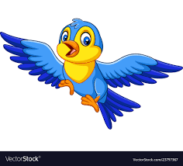
Flappy Bird
Janabelle

Slide 2
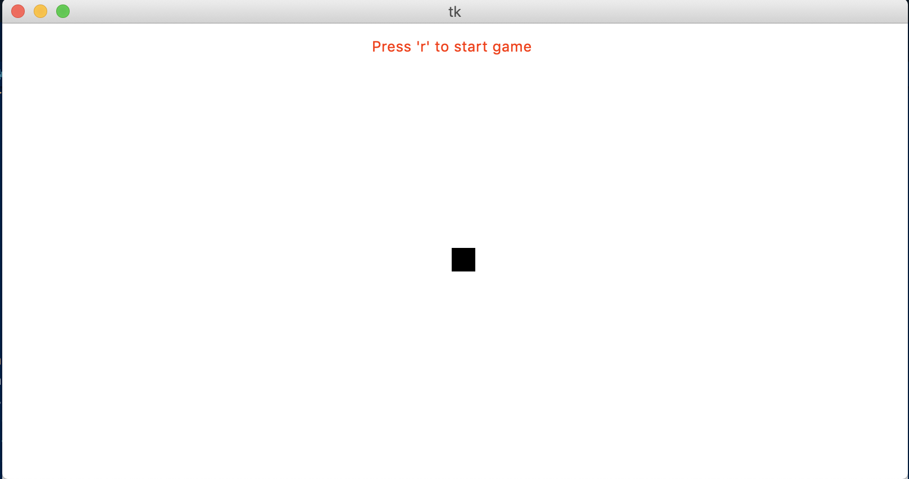
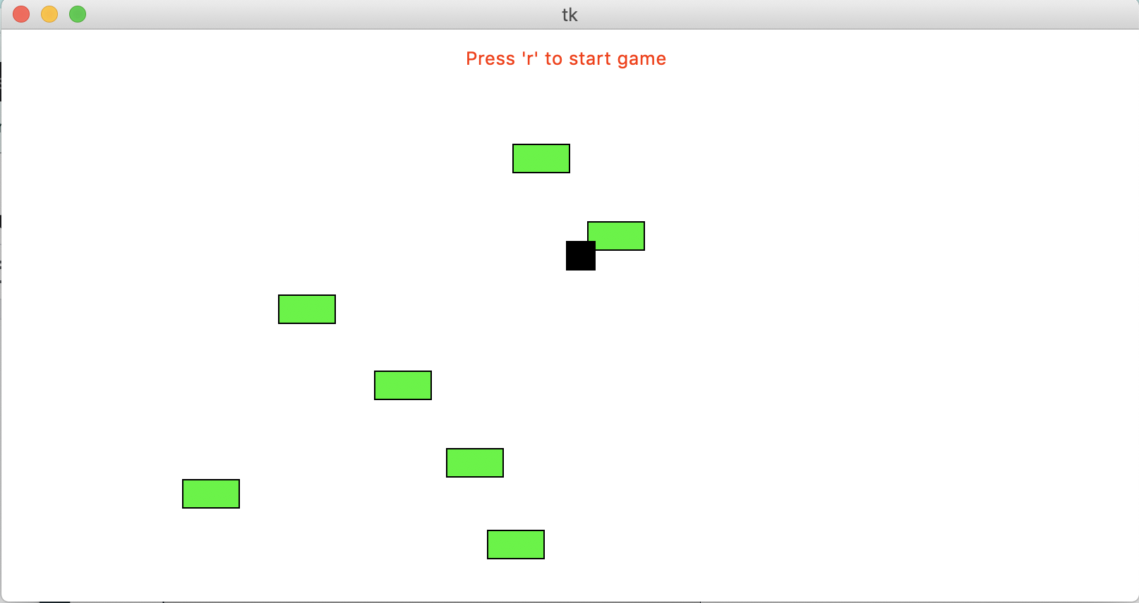
Demo
Bird
Asteroids

Slide 3
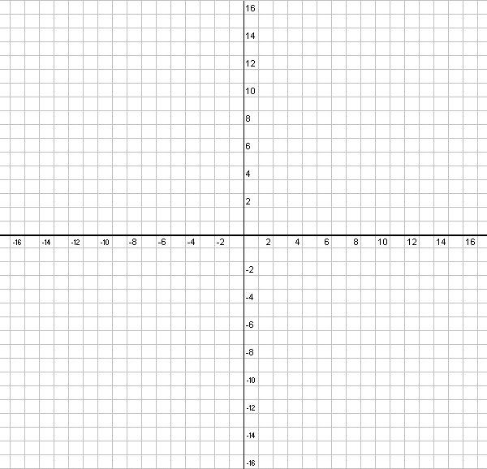
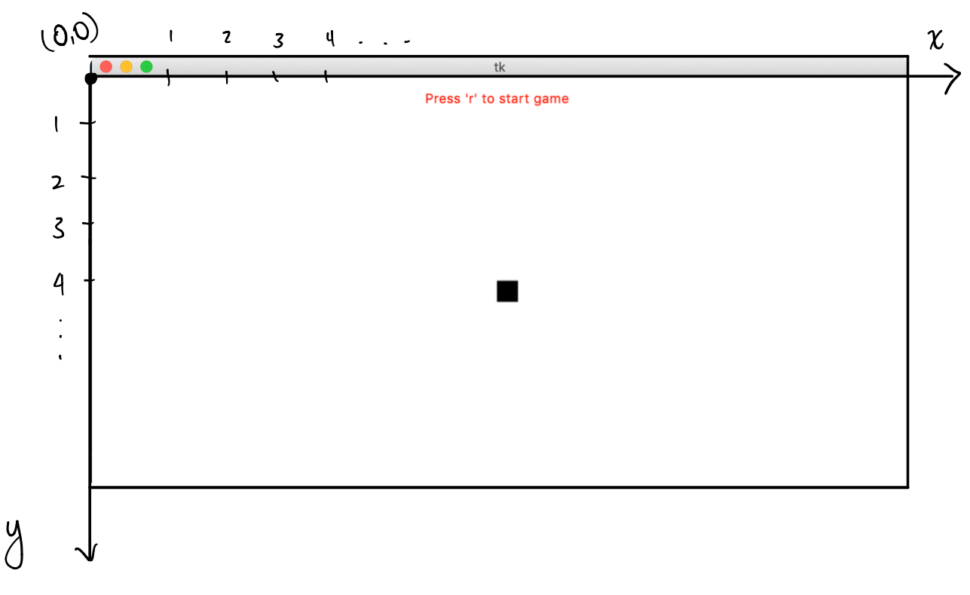
Tkinter
Python package, so we can create graphical programs
Mainly focus on how to use Tkinter to create games
Graph is different from what you have seen before

Slide 4
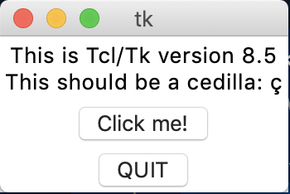
Tkinter Check
Alrighty! Everyone open a new file and type in
Import tkinter
tkinter._test()
When you run it, a popup window should show up

Slide 5
def init(data)
This function deals with the initial state of the game
Location of the bird
Size of the bird
Size of the asteroids
How high the bird flaps

Slide 6
def keyPressed(event, data)
def mousePressed(event, data)
keyPressed detects what button you pressed on the keyboard
Want to detect pressed ‘r’
if(event.keysym == "r"):
init(data)
Want to detect pressed ‘space’
if(event.keysym == “space"):
jump(data)
mousePressed detects when you click your mouse
Detects where you click on the canvas
Coordinates of where you click
event.x and event.y

Slide 7
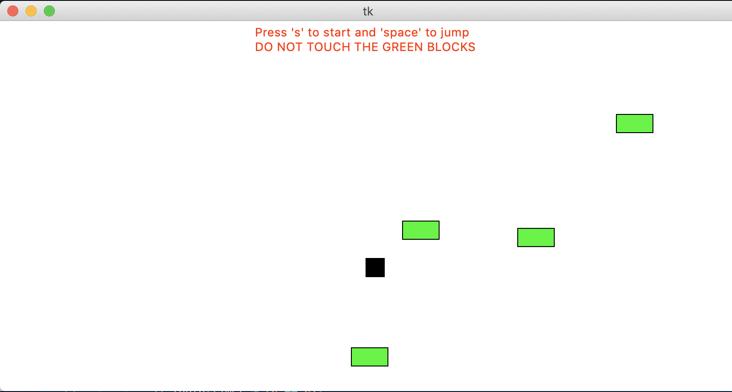
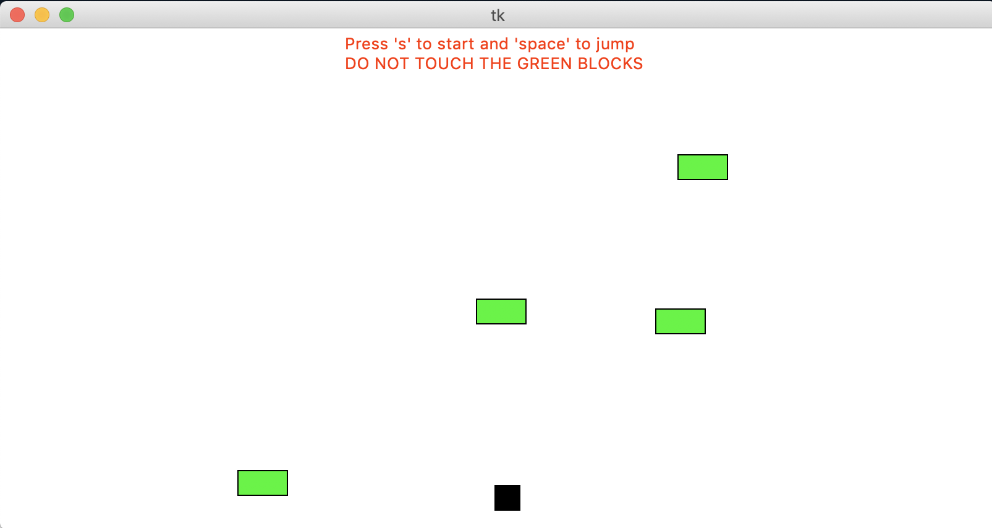
def timerFired(data)
Think about the game as a collection of pictures, one picture after another it will look like your games is moving
bird is flapping up and falling down
the asteroids are moving to the left
Called every second
BEFORE
AFTER

Slide 8
def drawBird(canvas, data)
Draw a rectangle on the canvas
canvas.create_rectangle(data.birdX, data.birdY,
data.birdX + data.birdWidth,
data.birdY + data.birdHeight,
fill='black')
canvas.create_rectangle (top left x location, top left y location, bottom right x location, bottom right y location, fill=’color’)
Top left (x, y)
Bottom right (x, y)

Slide 9
def drawText(canvas, data)
Draw/write text box on the canvas
canvas.create_text (400, 20, anchor=CENTER, text=instruction, fill='red')
canvas.create_text (x, y, text, fill=’color’)

Slide 10
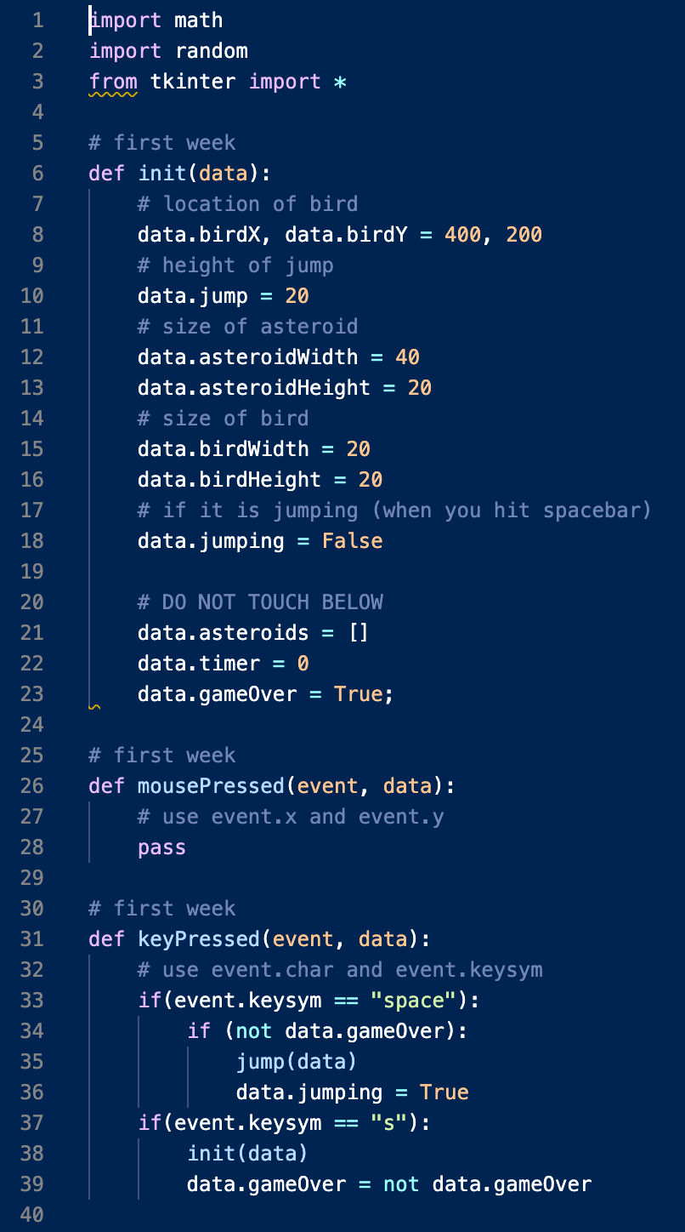
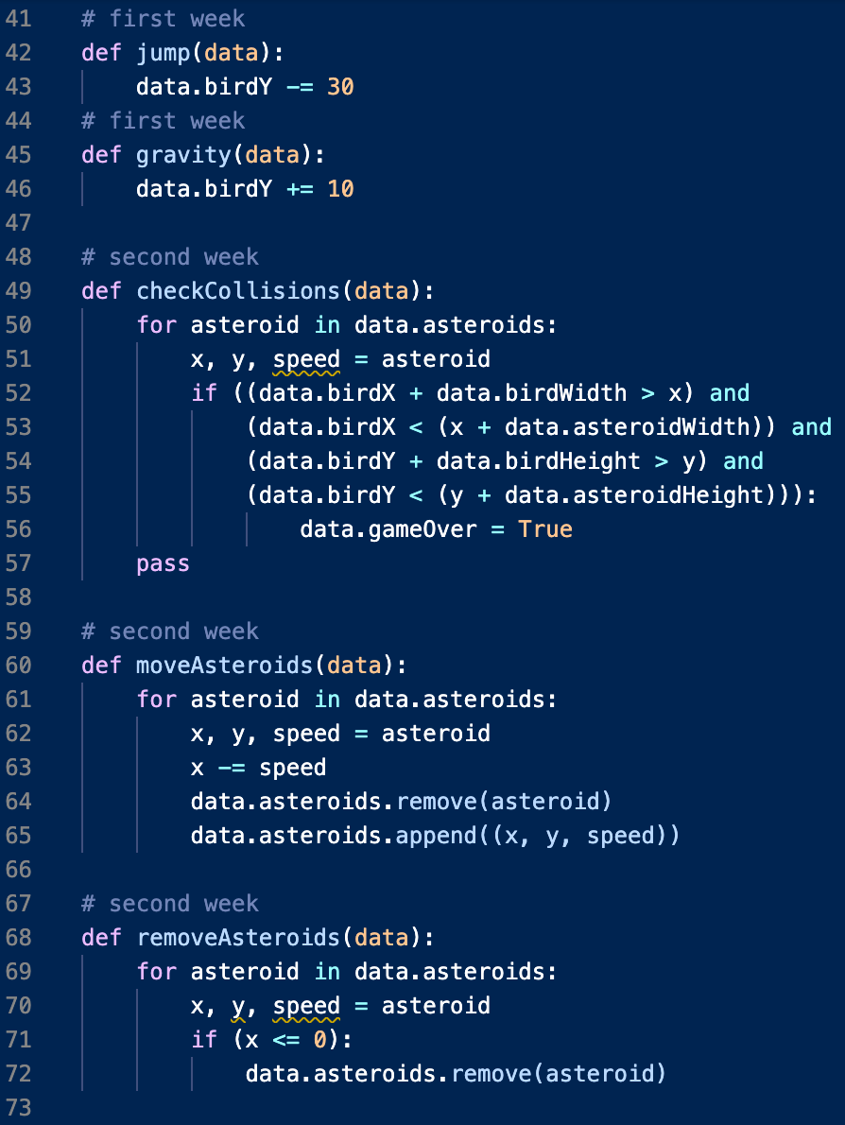
Code

Slide 11
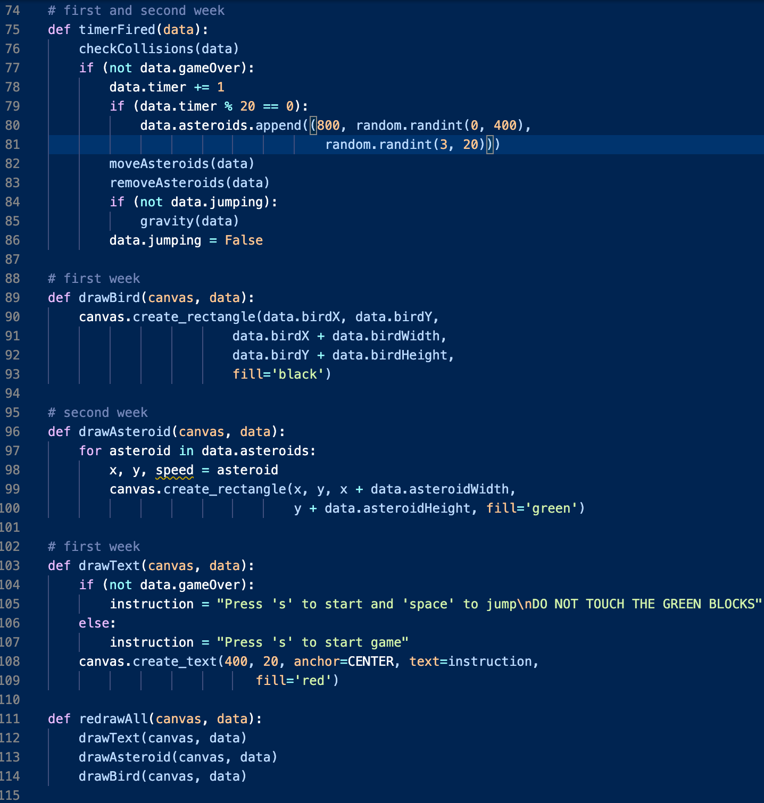
Code Part 2

Slide 12
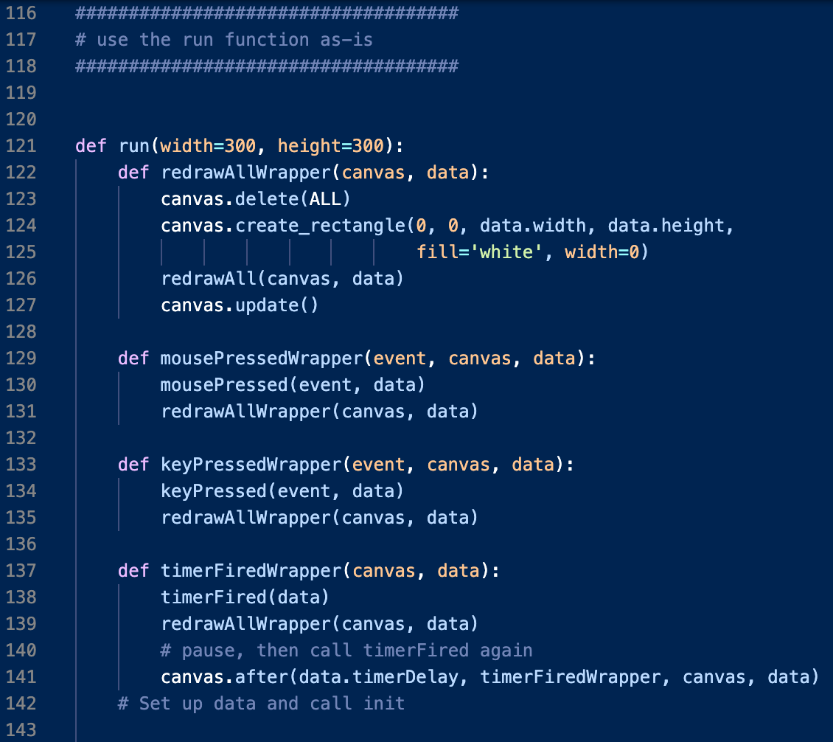
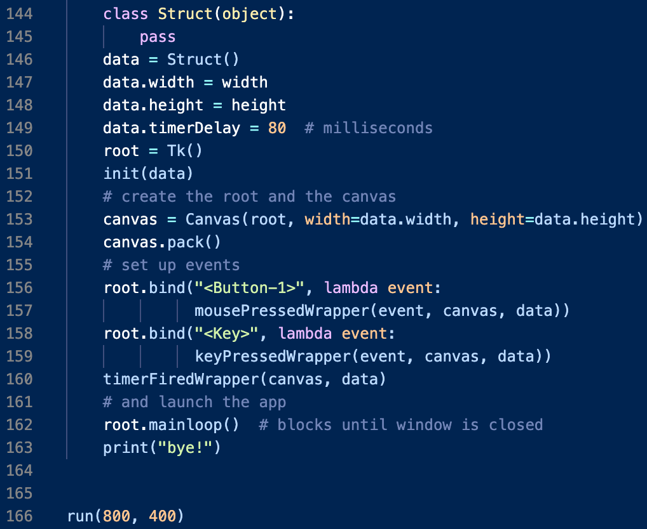
Code Part 3

